Slide 1

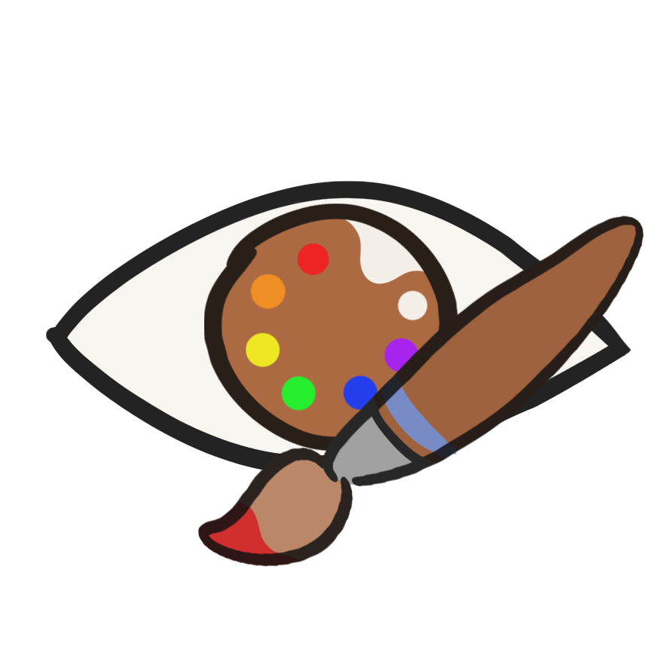
Art is Opinion
Eye tracker painting game

Slide 2
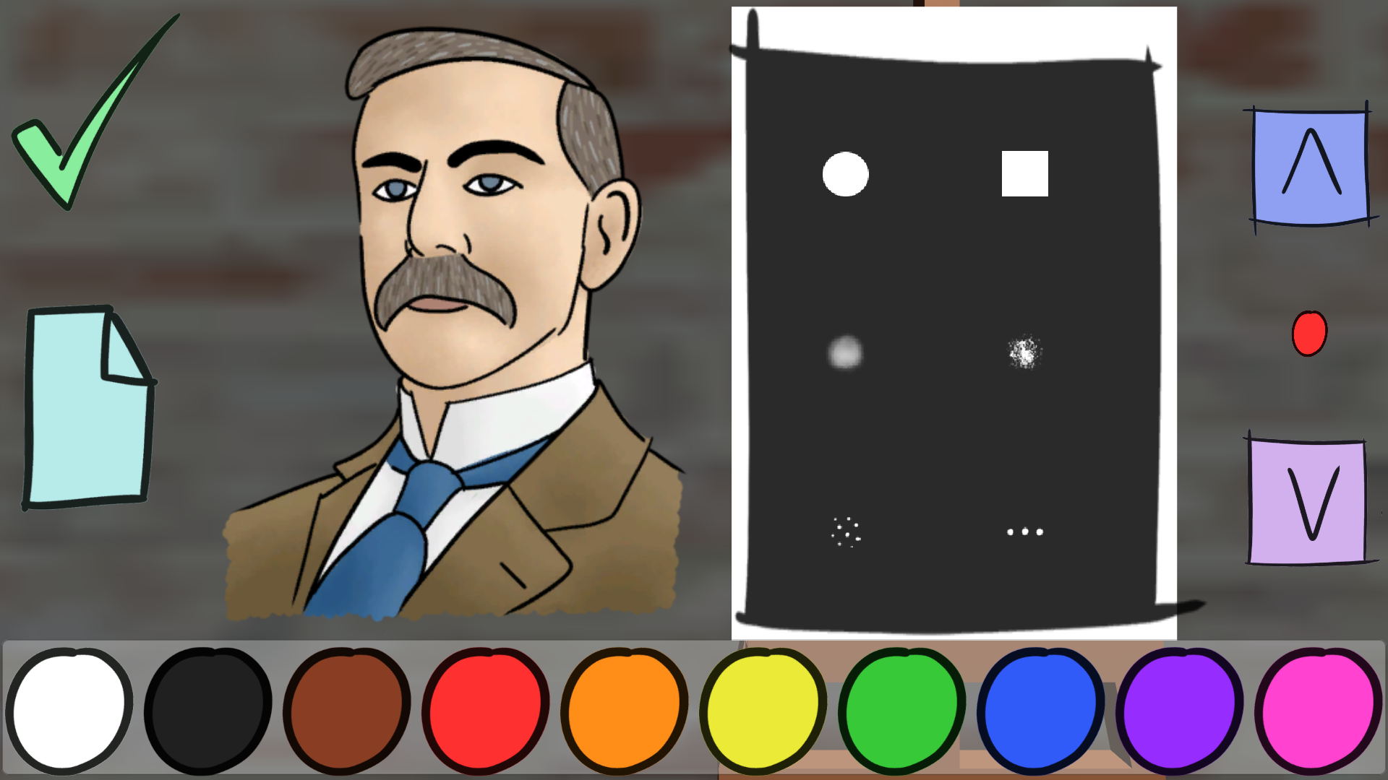
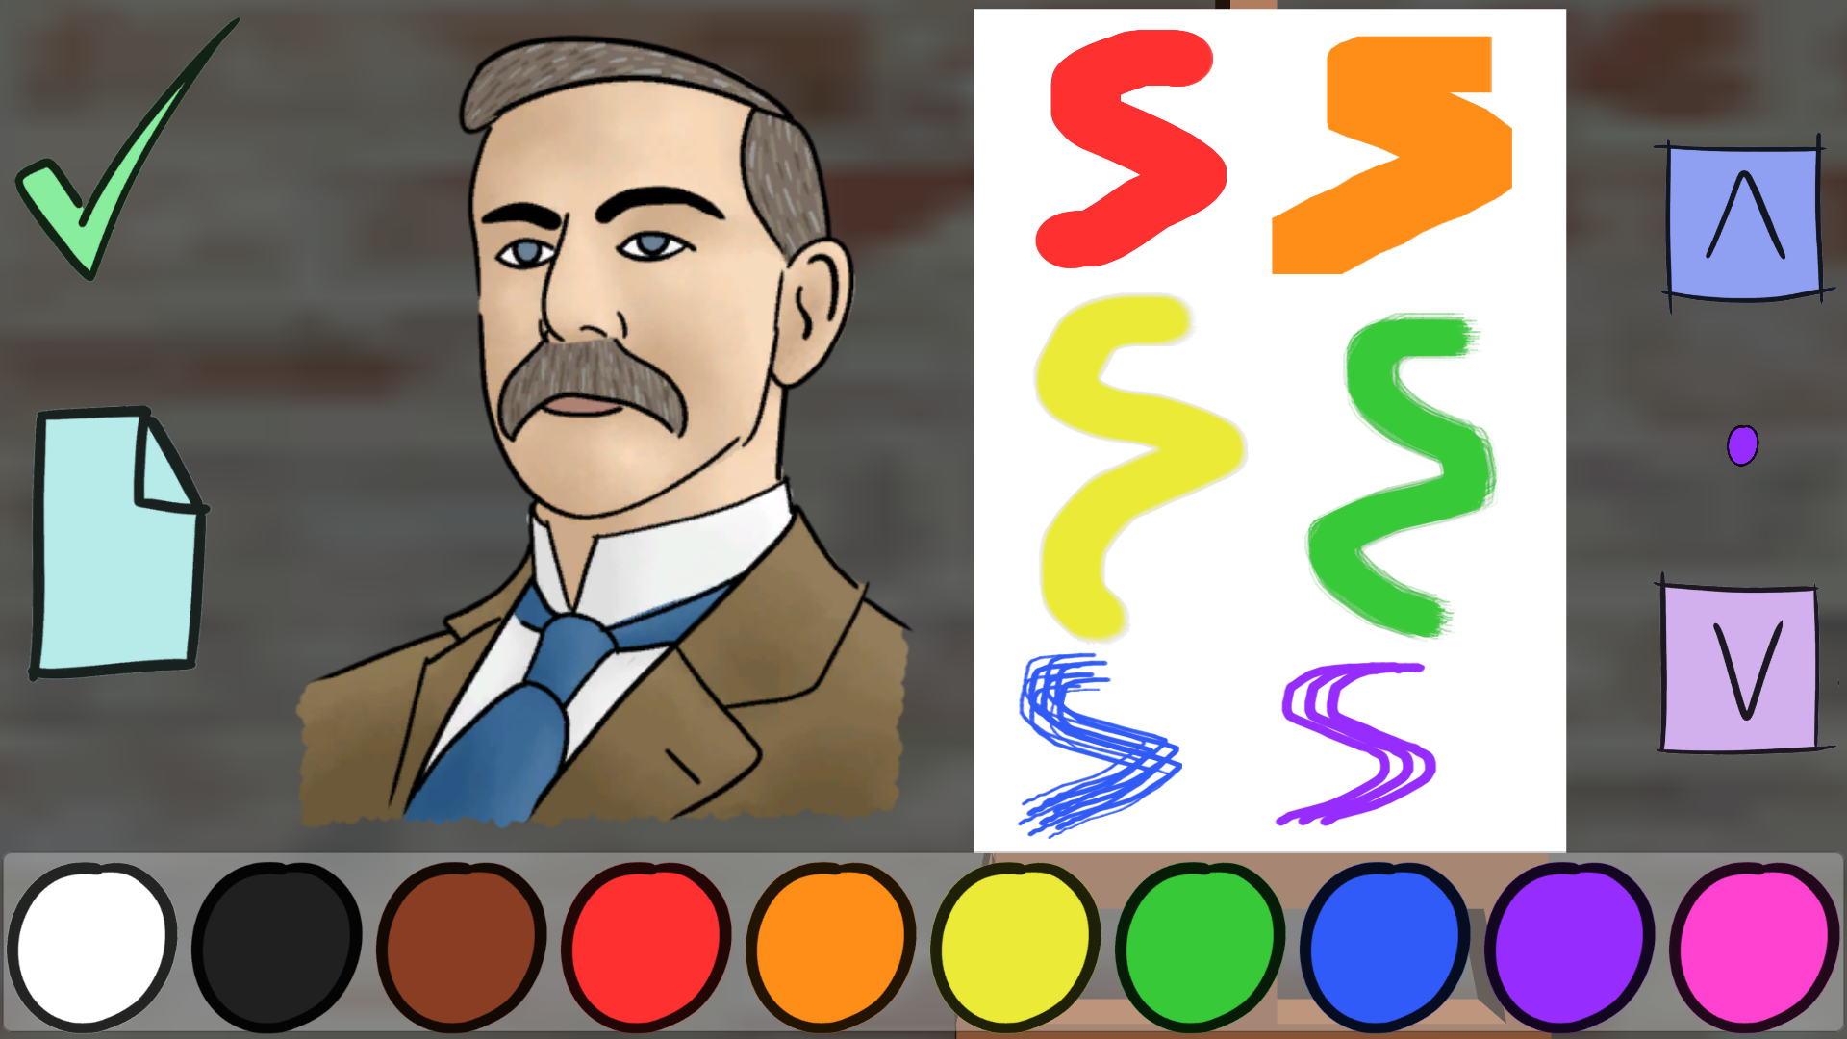
Current Features
Able to draw by tracing the character on the left with your eyes using the Tobii Eye-tracker
Can look at the character and draw on the canvas
Able to change the size and colour of the main brush with a preview
Has a free draw mode and a mode where you draw a random character
Can either accept or decline who you can draw
There is a gallery system to view the last 10 objects that have been saved by the player

Slide 3
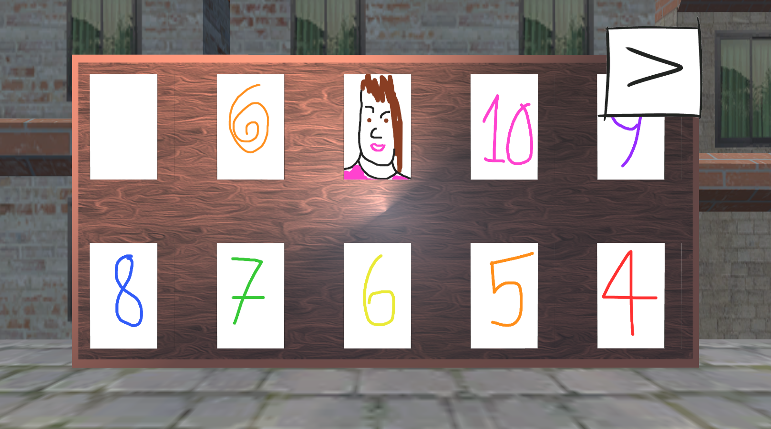
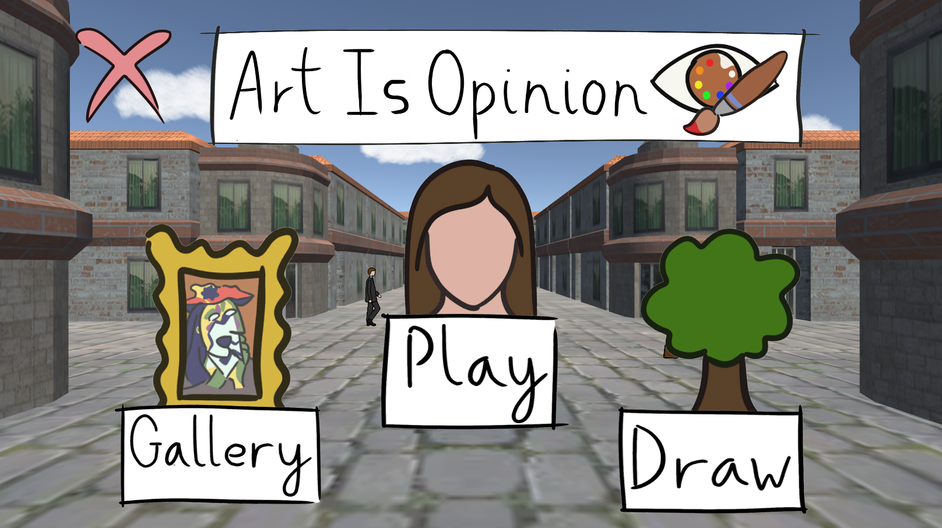
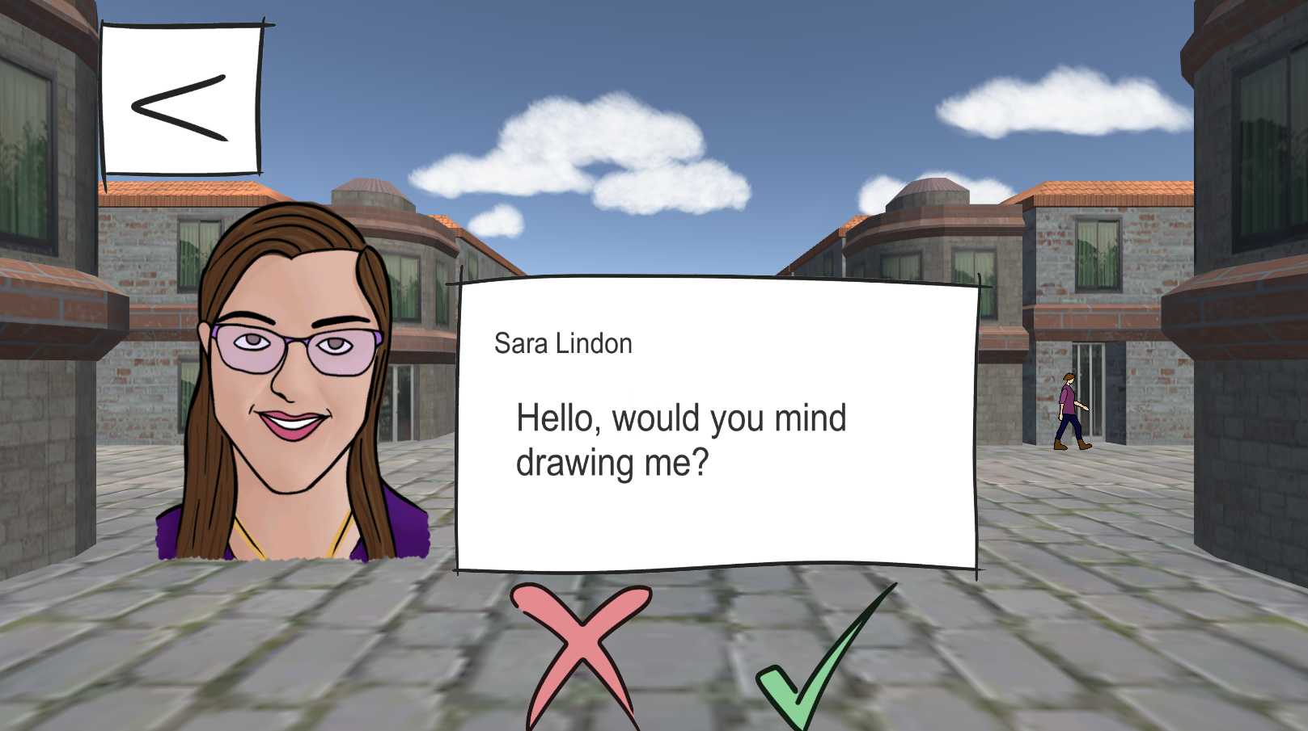
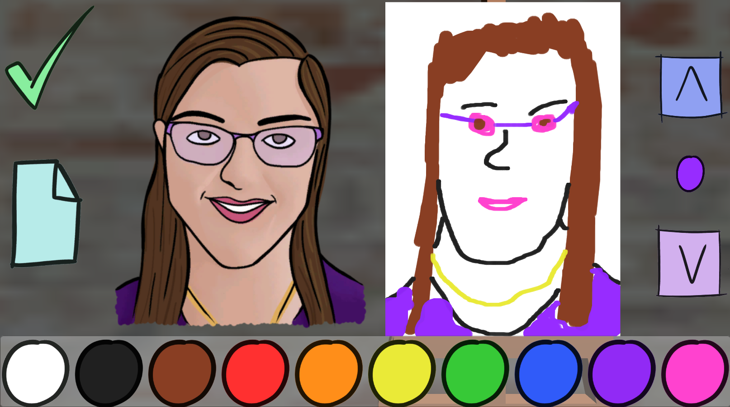
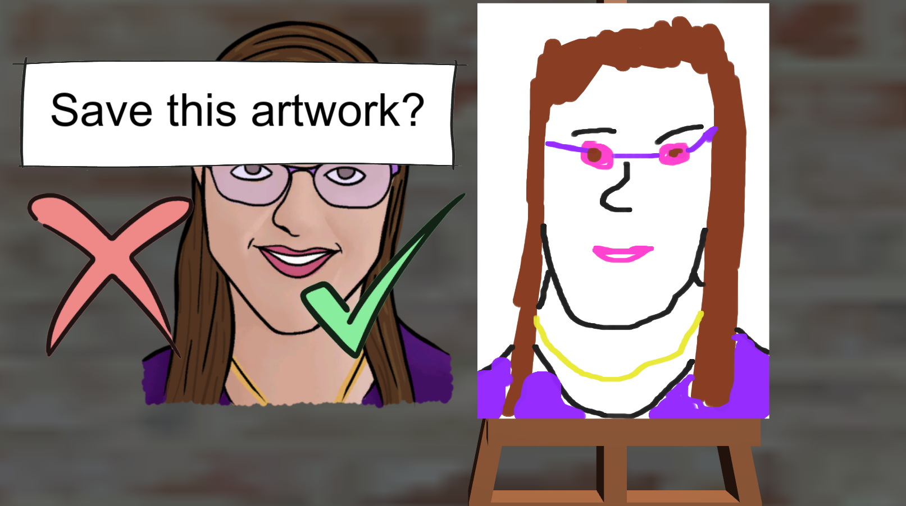
In Game images

Slide 4
What we would have done to improve
Refined Tobii response with easy access to equipment
Work on a fully working script that allows the player to change the size of the brush
Add dialogue that is the character commenting on the player's painting
Make changes to the Load Image Script to be able to load images into the gallery when there are less than 10 images saved

